Slide 1

Weather Prediction using Machine learning
Project Associates:
A.Gayathri (20NN1A1267)
J.Divya (20NN1A1287)
D.Komali (20NN1A1293)
CH.Madhupriya (20NN1A1275)
Project Guide:
Mrs. G. Lakshmi durga

Slide 2

TABLE OF CONTENTS
1
Abstract
2
Introduction
3
Literatury Survey
4
Existing Model Drawbacks
5
Requirement Specification
6
Proposed Model
7
Implementation
8
Conclusion
9
Future Enhancement

Slide 3

1 —
Abstract

Slide 4
This study investigates the efficacy of ensemble techniques in enhancing weather prediction accuracy. Ensemble methods combine the forecasts of multiple models to generate more robust and reliable predictions. By leveraging the diversity of individual models, ensemble techniques mitigate errors and uncertainties inherent in single-model forecasts. Through experimental evaluations and case studies, we demonstrate the effectiveness of ensemble methods in improving forecast accuracy and providing valuable uncertainty estimates. Overall, this research highlights the potential of ensemble techniques as a powerful tool for advancing weather prediction capabilities and supporting informed decision-making in various sectors.

Slide 5

2 —
Introduction

Slide 6
Weather prediction is a critical aspect of meteorology with far-reaching implications for various sectors, including agriculture, transportation, and disaster management. Traditional weather forecasting models often face challenges in accurately capturing the complex and dynamic nature of atmospheric processes. Ensemble techniques have emerged as a promising approach to improving the reliability and accuracy of weather predictions by leveraging the strengths of multiple forecasting models.
Ensemble methods, such as bagging, boosting, and stacking, combine predictions from diverse individual models to produce a consolidated forecast with improved performance. By integrating multiple models and incorporating their diverse perspectives, ensemble techniques can mitigate the limitations of individual models and provide more robust predictions.
Several case studies and experimental evaluations demonstrate the effectiveness of ensemble techniques in weather prediction across different spatial and temporal scales. These studies highlight the significant improvements in forecast accuracy and reliability achieved through ensemble methods compared to individual models. Furthermore, ensemble techniques can provide valuable uncertainty estimates, enabling decision-makers to assess the reliability of forecasts and make informed decisions in the face of uncertainty.
To address these challenges, meteorologists and researchers have turned to ensemble techniques, which have gained popularity for their ability to improve the quality and reliability of weather forecasts. Ensemble methods involve combining predictions from multiple individual models to produce a consensus forecast that often outperforms any single model. These techniques leverage the diversity of models, capturing different aspects of the underlying physical processes and statistical relationships in the atmosphere, thereby enhancing the overall predictive skill.
This introduction provides an overview of the role of ensemble techniques in weather prediction, highlighting their importance in addressing the challenges of uncertainty and variability inherent in atmospheric processes. In the following sections, we will delve deeper into the principles, methodologies, and applications of ensemble methods in weather forecasting, examining case studies, research findings, and future directions in the field. By harnessing the collective intelligence of diverse models and algorithms, ensemble techniques offer a promising avenue for improving the accuracy and reliability of weather predictions, ultimately benefiting society by enabling better preparedness and decision-making in the face of changing weather conditions.

Slide 7
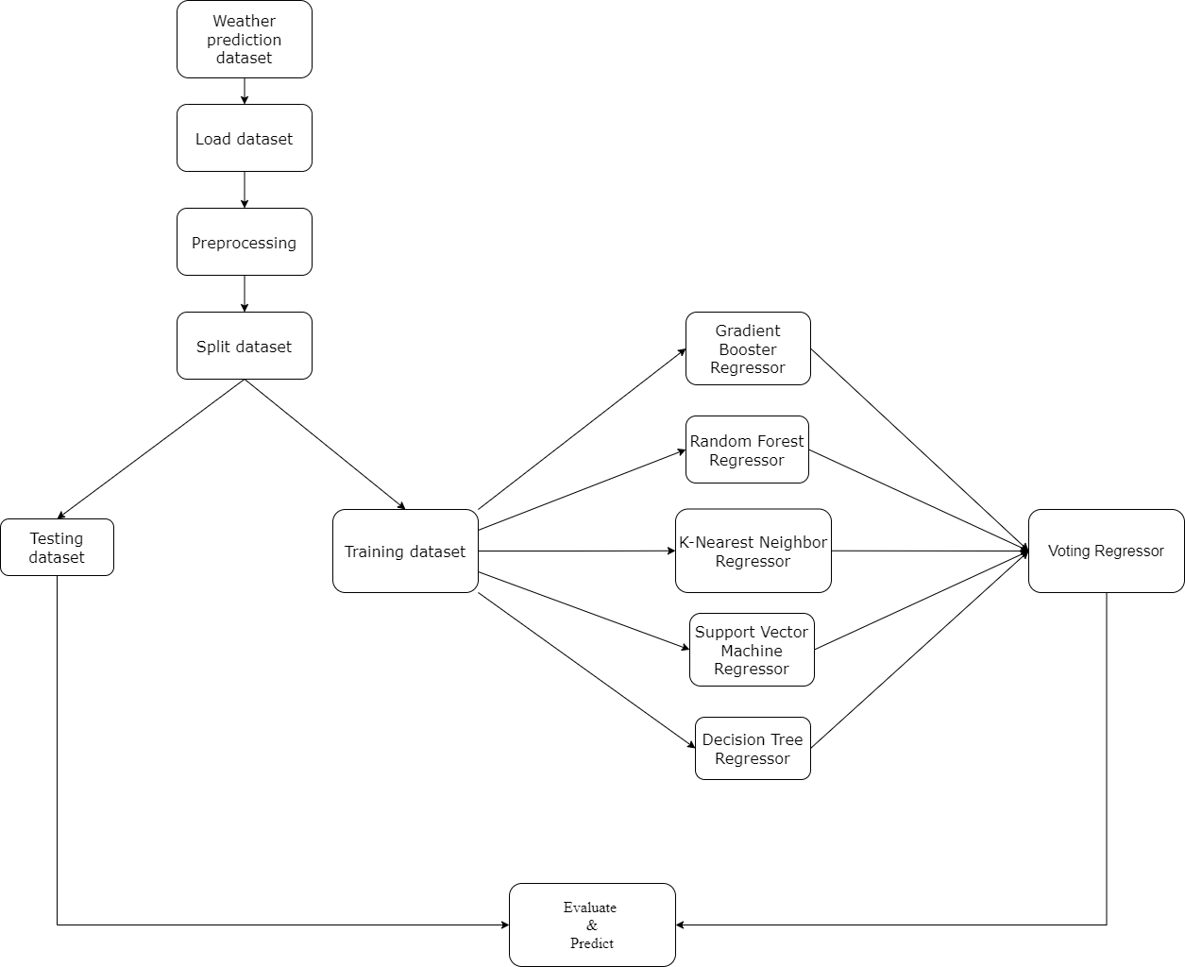
Block diagram

Slide 8
4 —
Existing Model Drawbacks

Slide 9
Traditional weather prediction models often rely on physical principles governing atmospheric dynamics and thermodynamics. These models simulate the behavior of the atmosphere using complex mathematical equations based on physical laws. They incorporate various factors such as temperature, pressure, humidity, wind speed, and direction to forecast weather conditions.
1. Approach:
Existing Models: Based on physical principles and mathematical equations.
Proposed Models: Utilize historical data to learn patterns and relationships between weather variables and predictions.
2. Algorithms used:
Traditional Models: It contains only 3 regressors in the existing voting regressor
Machine Learning Models: we added 2 more algorithms to the model and also added anther ensembling method called stacking to the model.
3.Performance:
Existing Models: It gives less accuracy and cannot perform well
Proposed Models: Here as we add more algorithms the accuracy can improve and also we can compare and see which algorithm gives best performance

Slide 10

5 —
Requirement Specification

Slide 11
Software Requirements:
Operating System: Windows 10.
Coding Language: Python.
Coding Environment: Google colab.
Hardware Requirements:
Preprocessor: Intel Core i3.
Hard Disk: 500 GB.
RAM: 4 GB.
Operating System: The code can be run on any operating system supported by Python, such as Windows, macOS, or Linux.
Internet Connectivity: The code does not require internet connectivity for execution, as it only performs data preprocessing, model training, and evaluation locally.
Execution Environment: The code can be executed in various environments such as Jupyter Notebook, Google Colab, or any Python IDE (e.g., Spyder, PyCharm).

Slide 12
USER REQUIREMENTS ANALYSIS
User Requirements Analysis is the process of determining user expectations for a new or modified product. These features must be quantifiable, relevant and detailed. The main user requirements of our project are as follows:
Dataset
Operating system
Intel i3 preprocessor
RAM 4 GB
Hard disk 500GB
python language and Google colab

Slide 13

6 —
Proposed Model

Slide 14
This code performs machine learning regression to predict temperature based on weather data. The data goes through several cleaning and pre-processing steps, including handling missing values, removing redundant features, addressing correlated features, creating new features from dates, and encoding categorical variables.
The code then trains and evaluates multiple regression models: Gradient Boosting Regressor, Random Forest Regressor, K-Nearest Neighbors Regressor, Decision Tree Regressor, and Support Vector Regressor. It also includes a Voting Regressor that combines predictions from all these models.
The final part evaluates the performance of each model using the R-squared score and Root Mean Squared Error (RMSE) on a hold-out test set. However, the code snippet doesn't explicitly show the selection of the best-performing model.
Overall, this code demonstrates a process for building and evaluating regression models to predict temperature based on weather data.

Slide 15
Algorithms Used
Random forest regression: Random Forest Regression is a supervised learning algorithm that uses an ensemble learning method for regression. The ensemble learning method is a technique that combines predictions from multiple machine learning algorithms to make a more accurate prediction than a single model.
Decision tree regression: It is a tree-structured classifier with three types of nodes. The Root Node is the initial node which represents the entire sample and may get split further into further nodes. The Interior Nodes represent the features of a data set and the branches represent the decision rules. Finally, the Leaf Nodes represent the outcome. This algorithm is very useful for solving decision-related problems.
KNN algorithm: The KNN algorithm assumes that similar things exist close. In other words, similar things are near to each other.
Support vector regression: The Support Vector Regression (SVR) uses the same principles as the SVM for classification, with only a few minor differences. SVMs can handle highly non-linear data using an amazing technique called kernel trick. It implicitly maps the input vectors to higher dimensional (adds more dimensions) feature spaces by the transformation which rearranges the dataset in such a way that it is linearly solvable.
Gradient Boosting algorithm: Gradient Boosting is a popular boosting algorithm. In gradient boosting, each predictor corrects its predecessor’s error. Each predictor is trained using the residual errors of predecessor as labels. There is a technique called the Gradient Boosted Trees.

Slide 16
Algorithm
Step: 1. Loads a dataset from a CSV file (`weatherHistory.csv`) into a Pandas Data Frame.
Step: 2. Performs data preprocessing steps like converting date columns to datetime, dropping irrelevant columns, and label encoding categorical variables.
Step: 3. Splits the dataset into training and testing sets.
Step: 4. Defines several regression models including Gradient Boosting, Random Forest, K Neighbors, Decision Tree, Support Vector Regressor (SVR), and a Voting Regressor ensemble of these models.
Step: 5. Trains these models on the training data and evaluates their performance using cross-validation, R-squared score, and root mean squared error (RMSE).
Step: 6. Visualizes the performance of different models using bar plots.
Step: 7. Implements a Stacking Regressor ensemble by combining the base models with a final Linear Regression model.
Step: 8. Evaluates the performance of the Stacking Regressor.

Slide 17
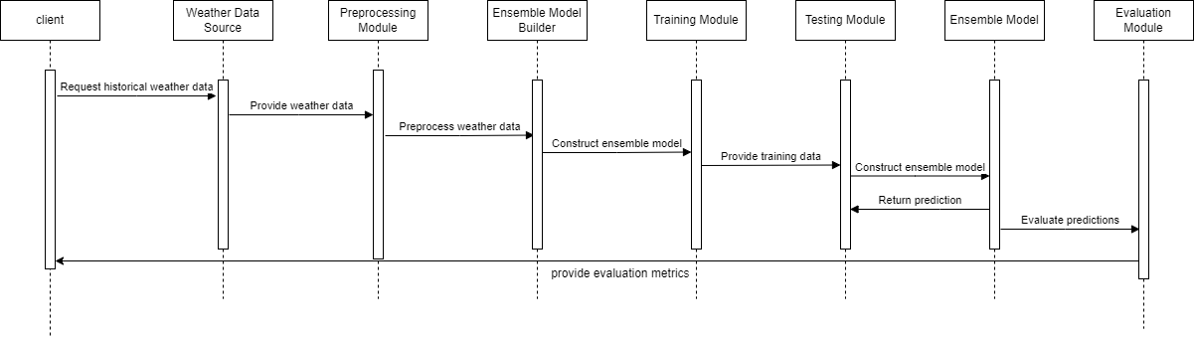
Sequence Diagram

Slide 18

7 —
Implementation&

Slide 19
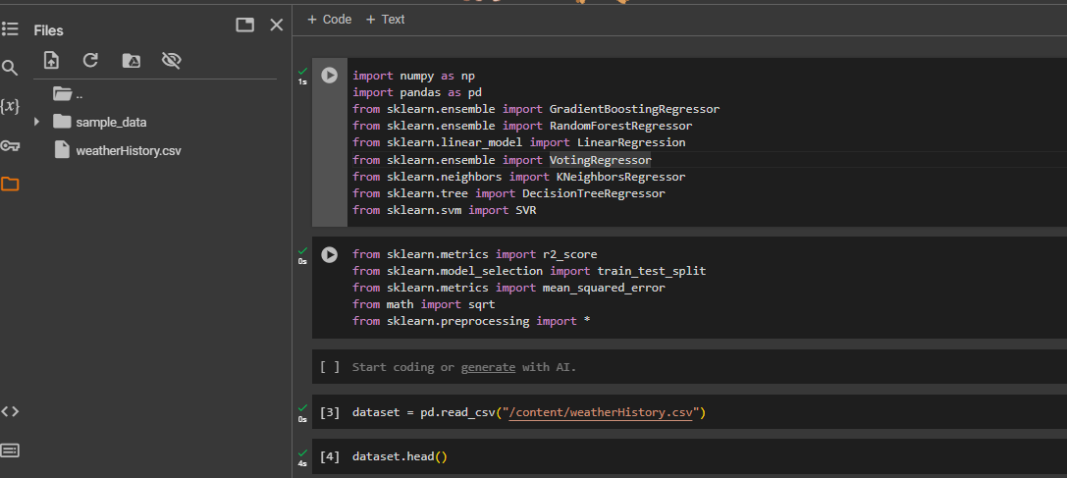

Slide 20
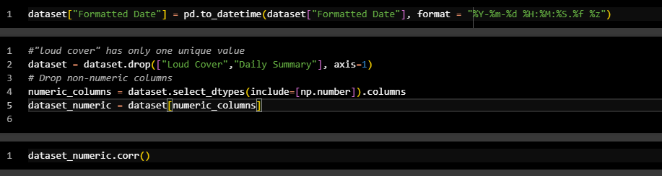

Slide 21
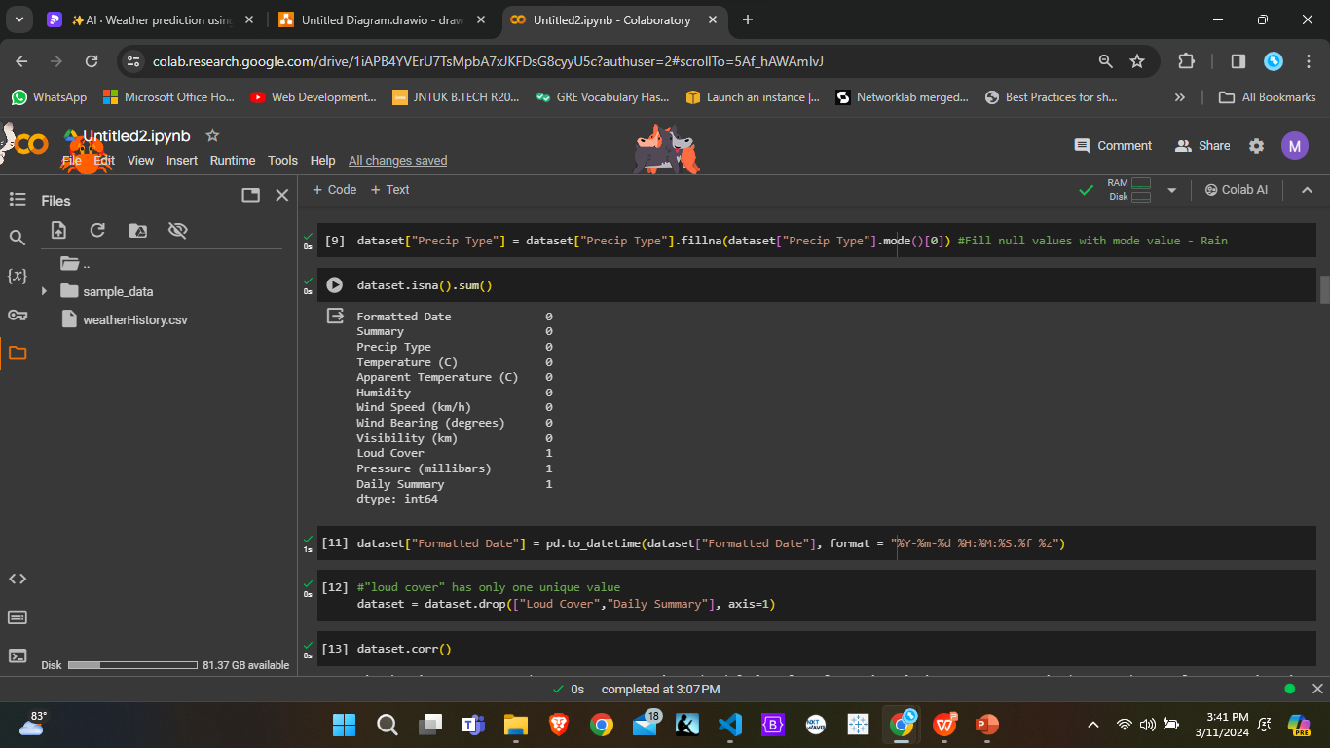

Slide 22
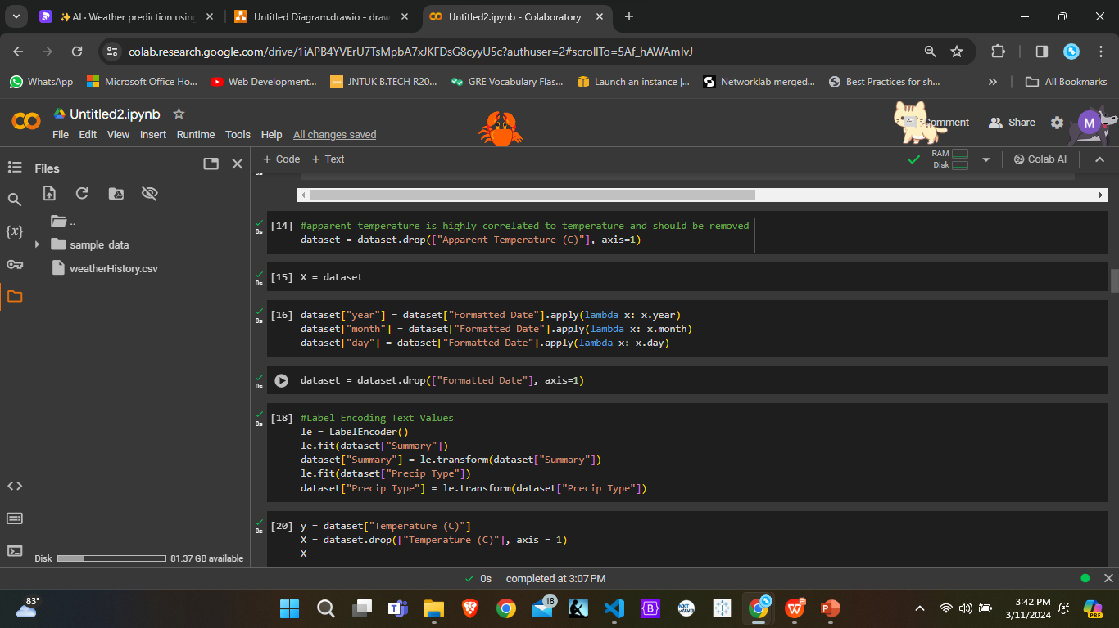

Slide 23
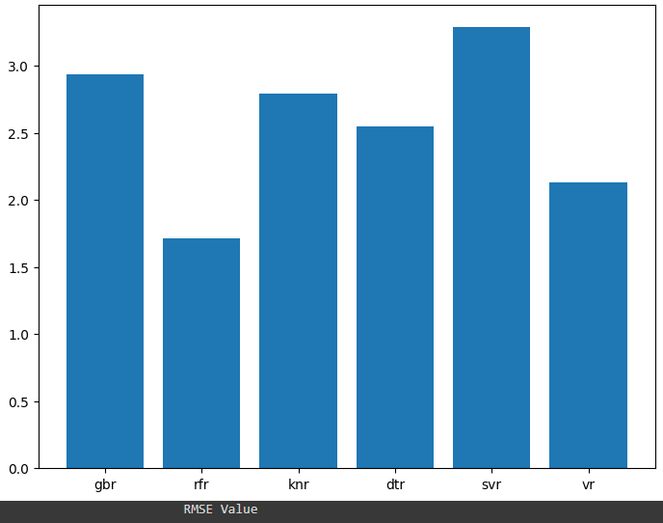
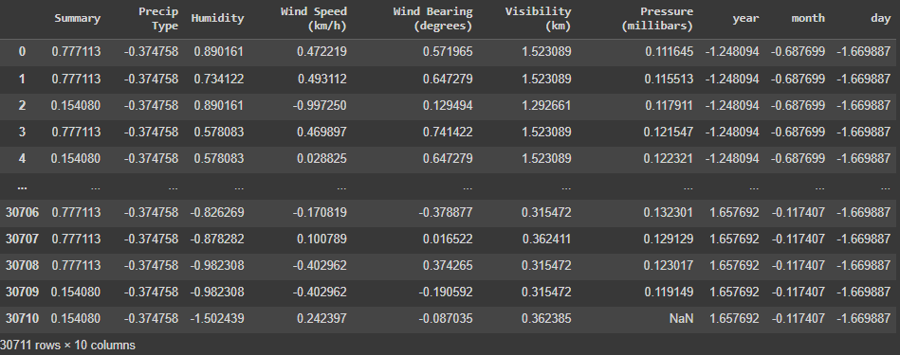
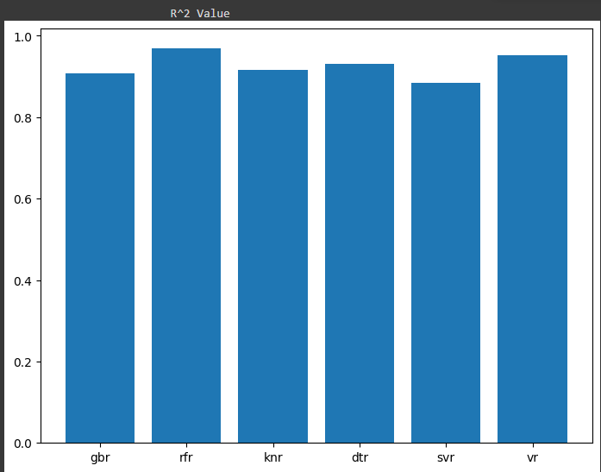
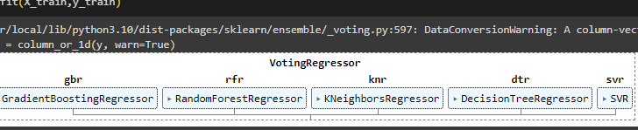

Slide 24

8 —
Conclusion

Slide 25
With the advancement of technology, weather forecasting has developed to its level best, but there is yet to develop, as far as nature is so unpredictable. Natural calamities and weather disturbances cause devastating destructions, surprisingly. To protect Earth, scientists and meteorologists are also advancing their knowledge about weather forecasting. Our project on Weather prediction using the ensemble technique has shown remarkable results in terms of accuracy and reliability. The code provides a comprehensive analysis of various regression models and ensemble techniques for temperature prediction. It demonstrates how to preprocess the data, train multiple models, evaluate their performance, and compare them using appropriate metrics. Both individual models and ensemble methods like Voting and Stacking are employed to improve predictive accuracy. The final evaluation of the Stacking Regressor provides insights into its performance compared to individual models and the Voting Regressor.

Slide 26
9 —
Future Enhancement

Slide 27
Hyperparameter Tuning: Perform hyperparameter tuning for each individual model and the stacking regressor to optimize their performance. Techniques like GridSearchCV or RandomizedSearchCV can be employed for this purpose.
Feature Engineering: Explore additional features or transformations that could improve model performance. This could involve creating new features from existing ones or using domain knowledge to engineer relevant features.
Model Interpretability: Implement techniques to interpret model predictions, such as feature importance analysis for ensemble models or partial dependence plots to understand the relationship between features and the target variable.
Model Selection: Explore additional regression algorithms beyond the ones used in your code to see if any other models perform better on your dataset.
Error Analysis: Conduct an in-depth analysis of prediction errors to identify patterns or systematic biases in the models and potentially address them through further data preprocessing or model refinement.

Slide 28
References
Singh, Nitin, Saurabh Chaturvedi, and Shamim Akhter. "Weather forecasting using a machine learning algorithm." 2019 International Conference on Signal Processing and Communication (ICSC). IEEE, 2019.
Bochenek, Bogdan, and Zbigniew Ustrnul. "Machine learning in weather prediction and climate analyses—applications and perspectives." Atmosphere 13.2 (2022): 180.
Ren, Xiaoli, et al. "Deep learning-based weather prediction: a survey." Big Data Research 23 (2021): 100178.
Scher, Sebastian, and Gabriele Messori. "Ensemble methods for neural network‐based weather forecasts." Journal of Advances in Modeling Earth Systems 13.2 (2021).
Wu, Hao, and David Levinson. "The ensemble approach to forecasting: A review and synthesis." Transportation Research Part C: Emerging Technologies 132 (2021): 103357.

Slide 29

THANK YOU
The End

